Slide 1

SDEV1701
Day 12 Box Model and Max-width

Slide 2

Today’s focus
Welcome to Day 12! Today we’re going to:
Learn about CSS Box Model works and how it affects layout.
Explore how to use padding, borders, and margins
Learn how to center content using max-width and margin
Understand why we use reset files
Start thinking about responsive design

Slide 3
The Box Model

Slide 4
CSS Cascade Refresher
In CSS, every element on a page is treated like a rectangular box—even if it doesn’t look like one.
This box is made up of four layers, from the inside out:
Content
Padding
Border
Margin (space between boxes)

Slide 5
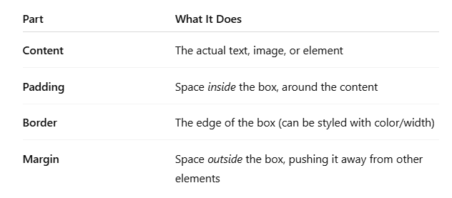
The 4 Parts of the Box

Slide 6
The 4 Parts of the Box
Content Box
The area where your content is displayed.
Size it using properties like width, height, inline-size, block-size.
Padding Box
White space around the content.
Size it using padding and related properties.
Border Box
Wraps the content and any padding.
Size it using border and related properties.
Margin Box
Outermost layer, providing spacing between boxes.
Size it using margin and related properties.

Slide 7
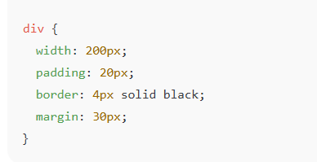
Example
That box will actually take up:
Content: 200px
Padding: 20px on each side (adds 40px total)
Border: 4px on each side (adds 8px total)
Margin: 30px outside the box (doesn’t count toward size, but creates space)
Total visual space = 200 + 40 + 8 = 248px wide box. Then it has 30px of extra space around it (the margin).

Slide 8
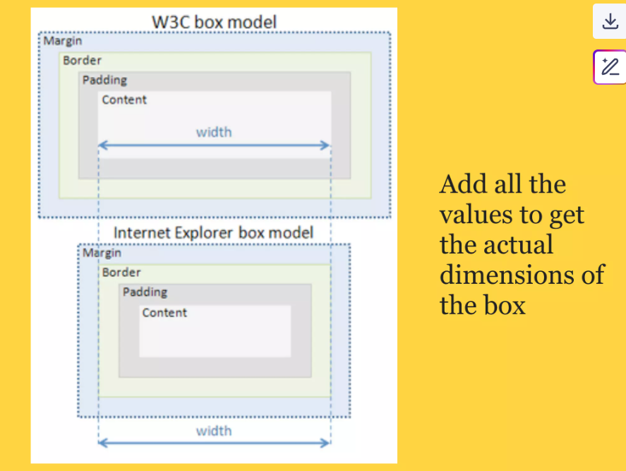
Example

Slide 9
Why Does the Box Model Matter?
It affects layout and alignment
If you forget about padding, your content might overflow or appear off-center
Borders and margins add space — but in different ways
You need to calculate total size (width + padding + border)

Slide 10
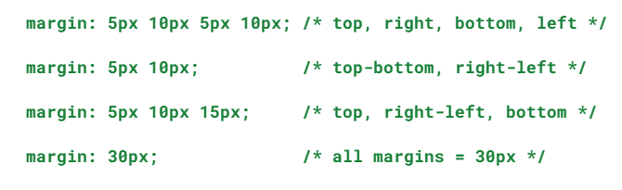
Margin
Shorthand Examples:

Slide 11
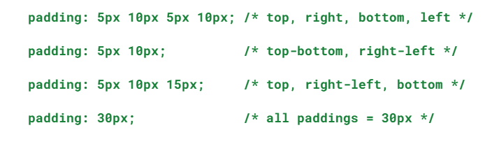
Padding
Shorthand Examples:

Slide 12
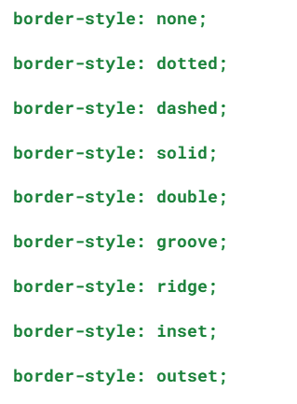
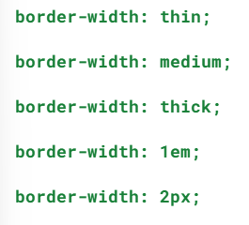
Border Properties
Border Width and Border Style

Slide 13
Introducing box-sizing
box-sizing allows you to:
Set one overall width for an element
The browser will subtract padding and border from the content space
This keeps the element’s total size consistent
⚠️ Margins are still calculated separately — they are outside the box. That’s why if we add left and right margin it can break centering margin we add in inner-container

Slide 14
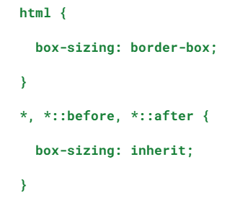
Universal Box-Sizing
Applies box-sizing to all elements
Ensures pseudo-elements (like ::before, ::after) are included
(they do not inherit box-sizing by default) and will be added to our reset file.
This is the modern standard and is usually added in CSS resets.

Slide 15
CSS RESET

Slide 16
What is a CSS Reset?
A CSS reset is a stylesheet (usually a separate .css file) that removes default browser styles from all elements.
Every browser (Chrome, Firefox, Safari, etc.) comes with its own built-in styles for headings, margins, padding, etc. (Remember on our first day our text looked different depending on browser we used?)
This means:
The same HTML looks slightly different in each browser.

Slide 17
Why Do We Need a Reset File?
Because we want:
Consistency across browsers
A clean starting point
Full control over layout, spacing, fonts, etc.
Without a reset:
<h1> might have 32px top margin in one browser and 40px in another.
<ul> might have bullet styles or padding by default.
<button> might look different on Mac vs. Windows.
*A reset file makes everything neutral and predictable.

Slide 18
Types of resets
Modern Perspective:
Browser compatibility has improved.
Heavy-handed resets may no longer be necessary.
Instead, consider a modern CSS reset — lighter and more practical.
Piccalilli Modern CSS Reset
Removes default margins from only some elements.
Adds box-sizing: border-box;
Lightweight and modern.
We will be using modified version of it.
🔗 https://piccalil.li/blog/a-modern-css-reset

Slide 19
Types of resets
Normalize:
Maintains useful default styles like typographic structure.
Fixes browser-specific bugs (desktop and mobile).
Uses vendor prefixes like -webkit-, -moz-, etc.
🔗 https://necolas.github.io/normalize.css/

Slide 20
Types of resets
Bootstrap Reboot
Built on top of Normalize.
Adds its own styles to many elements.
Helps your page look more modern from the start.
📌 Part of the Bootstrap Framework. You’ll learn more about it later in the course.
🔗 https://getbootstrap.com/docs/5.2/getting-started/download/

Slide 21
Responsiveness and max-width

Slide 22
What is max-width in CSS?
max-width is a CSS property that sets the maximum width an element is allowed to be.
It tells the browser:
"This element can shrink and grow, but never get wider than this value."

Slide 23
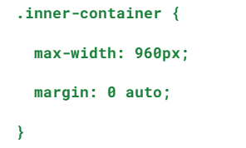
Why use max-width?
Because it helps your layout be responsive and fluid—it adjusts to different screen sizes without breaking the layout.
This centers content inside a container and prevents it from stretching too wide on large monitors.

Slide 24
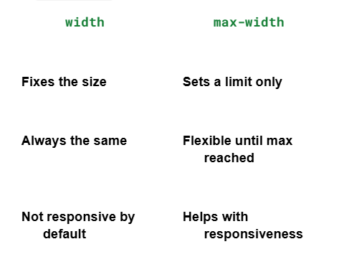
How is it different from width?

Slide 25
What Is the Viewport?
The viewport is the visible area of the browser window—in other words, what you can see on your screen without scrolling.
It changes based on:
Device (desktop, tablet, phone)
Window size (if resized)
Zoom level
So when we say "full viewport width," we mean: stretching across the entire screen, edge to edge.

Slide 26
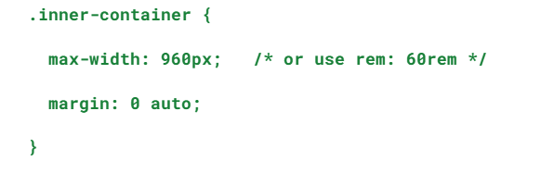
What Is .inner-container?
.inner-container is a common class we use to center and constrain content inside a full-width section.
Instead of having all your content pushed to the sides or stretched across a giant screen, we do this:

Slide 27
What this does:
max-width: 960px → The content will not get wider than 960px, even on a huge screen.
margin: 0 auto → This horizontally centers the container inside the full-width element.

Slide 28
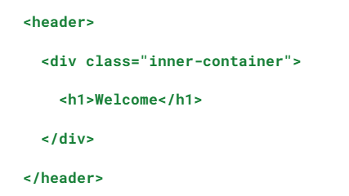
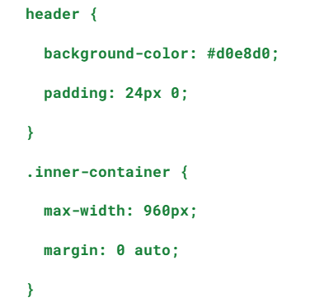
Why Do We Use .inner-container Inside a Full-Width Section?
Let’s say you want your background color to stretch full screen, but keep your text centered and readable. You would do this →
Result:
The header has a full-viewport green background.
The .inner-container keeps your content neatly centered and readable.

Slide 29
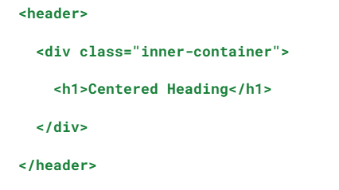
Where You Place It Matters
Always place the .inner-container inside the section (<header>, <main>, <footer>, etc.), like this →
Avoid wrapping header in inner-container (or you’ll lose the full-width background).

Slide 30
Summary and Reflection

Slide 31
Reflection Prompt
What is one key takeaway about the Box Model?
How does max-width improve responsive layouts?"

Slide 32
Homework
Exercise: Hands-on CSS Box Model Implementation
Practice with Diner Game

